Slide 1
Learning
PSY 101, BRAC University

Slide 2
What can you do now that you couldn’t do as an infant?
Notes:
Yeah, we don't actually know what the internal mental life of an infant's like. But it
doesn't seem like they remember many very specific things about their lives. You
do. But you know it's a lot more than, you know a ton of stuff, a lot of facts, right,
things about the world, the values you hold, about your family, your culture, the
country or countries you've grown up in. You just know a ton compared to an infant.
And there's only two ways that you know this. It's either in your genes when you're
born or you learned it through life. And so we're going to talk today about how
scientific psychology tries to approach learning. And in a remarkable thing about
learning is we often think, well, we're learning lessons or whatever. We're learning
material.

Slide 3
Learning
how behavior changes within the lifespan of an individual
everything we know that is not genetically given
how to predict the future on the basis
of past experience
to imbue the world with meaning
learning about learning through scientific psychology
Notes:
But the important part of learning the way we think about it is that it allows us to
predict the future on the basis of the past, right? We want to learn lessons in life to
know what's desirable, what's dangerous, what's a smart way to do things so we're
more effective. We choose what we want to do better in the future to learn from the
past and predict the future.
It imbues our word with meaning. For an infant, not much means much, right? They
just look around. Who knows what anything means. Words, gestures, facial
expressions, there's not much meaning of the world out there. For you, the world is
full of meaning, history, social interactions, everything that you're thinking about. So
how do we acquire the meanings of things in the world that matter to us?
And it's also had an interesting kind of a give and take with how we learn about
learning in scientific psychology and sort of historically. And we'll talk about three aspects of learning today: classical conditioning,
operant conditioning, and then various ways in which there are limits to conditioning.

Slide 4
Learning
Classical Conditioning
Operant Conditioning
Observational Learning

Slide 5
Classical Conditioning

Slide 6

Association of a Song with Fond Memories
Music can be a very powerful stimulus. Sometimes in our lives we may have experiences that are very significant, such as meeting the love of our life for the first time. If that moment happens while a certain song is playing, then the two may become associated.
Then, whenever that song is heard it can trigger our memory of meeting that person. The association between the song and event of meeting can last a very long time, even decades.
Even after the relationship has terminated, the memory can still persist and be triggered by that particular song. It’s unfortunate, but that is the way classical conditioning works.

Slide 7
Ivan Pavlov (1849-1936)
Nobel Prize for reflexes of digestion - food in mouth provokes specific salivation to prepare for digestion - salivation reflexes
"But Professor, there's a revolution going on with shooting in the streets."
"What difference does it make when you've work to do in the laboratory? Next time there's a revolution, get up earlier!“
cut esophagus so food could not go to stomach
placed food in dog's mouth, stomach secreted plenty of gastric juice
sight of food or sight of feeder - psychic secretions or conditioned reflex

Slide 8
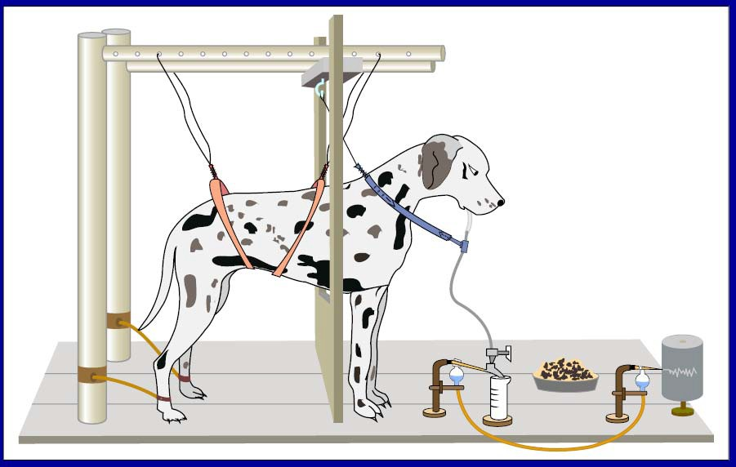
PAVLOVIAN CONDITIONING
A modification of Pavlov’s method
Image by MIT OpenCourseWare.

Slide 9
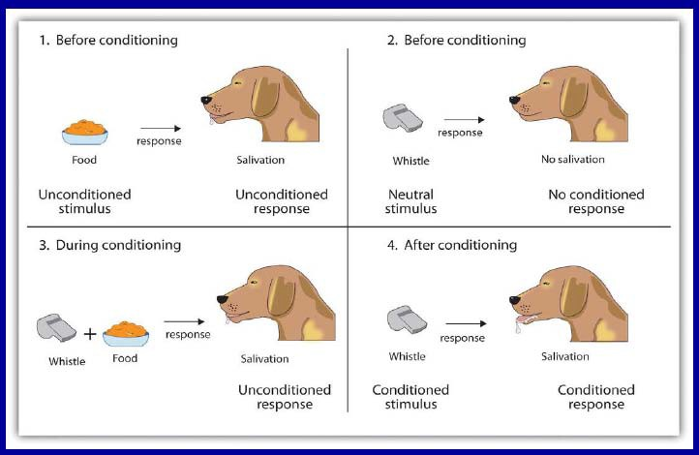
Classically Conditioning a Salivation Response
Source: Stangor, C. Introduction to Psychology. Flatworld Knowledge, 2010. Courtesy of Flatworld Knowledge.

Slide 10
Unconditioned Stimulus (UCS) – food
Unconditioned Response (UCR) - salivating (food)
Conditioned Stimulus
(CS) – bell
Conditioned Response (CR) – salivating
new association !!
bell (CS) & salivating (CR)

Slide 11
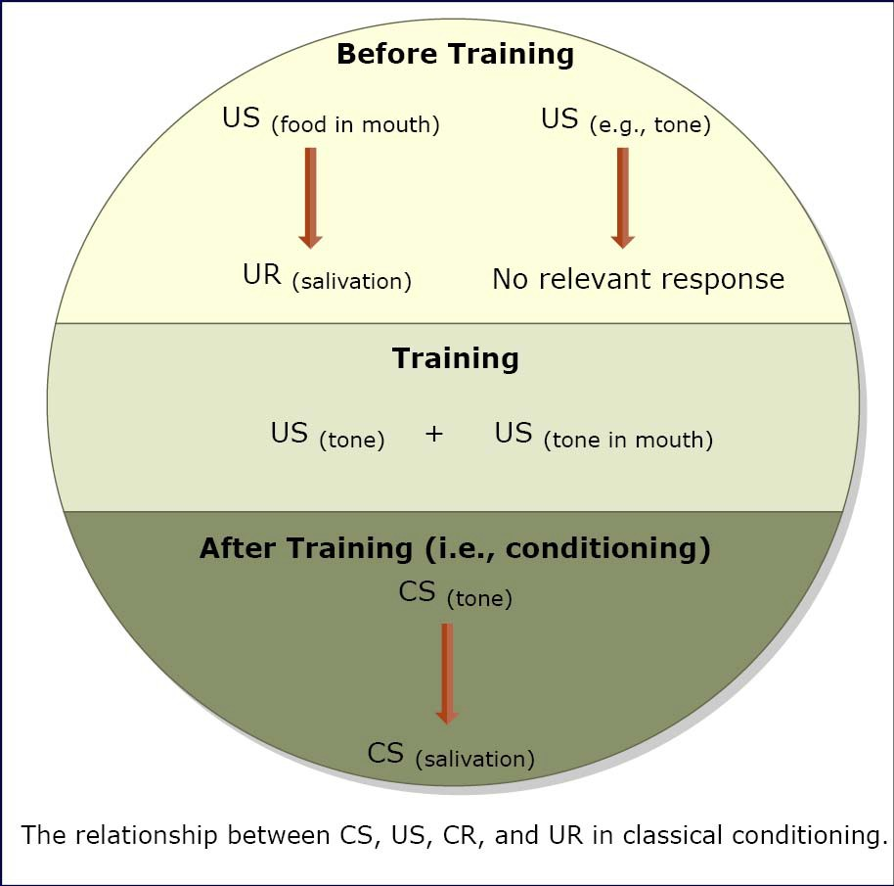
Image by MIT OpenCourseWare.
Image by MIT OpenCourseWare.

Slide 12
Little Albert Experiment! Classical Conditioning in a Baby
The Little Albert Experiment

Slide 13
Instrumental/Operant Conditioning
operate as instruments to produce desired effect
E. L. Thorndike (1898)
puzzle box - cat had to unlatch door by pulling latch - trial and error - fewer errors over time -
where is US? consequence of response
Law of Effect
consequence of a response determines whether it is strengthened or weakened
Reward - Strengthened No Reward - Weakened
Punishment - Very Weakened
Notes:
So we're going to discuss what instrumental conditioning is. And then we're going to
slightly think philosophically about whether this is how you learn to do everything.
You get to choose who the applause comes from, your parents, your family, your
friends, medical schools and law schools and graduate schools. You get to choose
who the applause comes from, about how much of our lives is responding to the
applause that we care about

Slide 14
B. F. Skinner (1904-1990)
consequences of responses
operant response is an action that operates on environment to produce some consequence
operant behavior

Slide 15
Reinforcement means you are increasing a behavior.
Reinforcement can be positive or negative
Punishment means you are decreasing a behavior.
Punishment can also be positive or negative.

Slide 16
REINFORCEMENT
Primary Reinforcers food, thirst, pain
Secondary Reinforcers
money, attention, praise, admission, promotion
Positive (increase behavior)
Negative (decrease behavior, escape)
Punishment
Partial Reinforcement

Slide 17
Reinforcement:
Adding or removing something to increase desired behaviors.
Punishment
Adding or removing something to decrease undesirable behaviors.

Slide 18
Positive Reinforcement & Negative Reinforcement
Positive reinforcement is a process that strengthens the likelihood of a particular response by adding a stimulus after the behavior is performed.
Example: Allowing a child to play on their tablet if they finish their homework.
Negative reinforcement also strengthens the likelihood of a particular response, but by removing an undesirable consequence.
Example: Keeping the mobile in silent mode so that your concentration level increases.

Slide 19
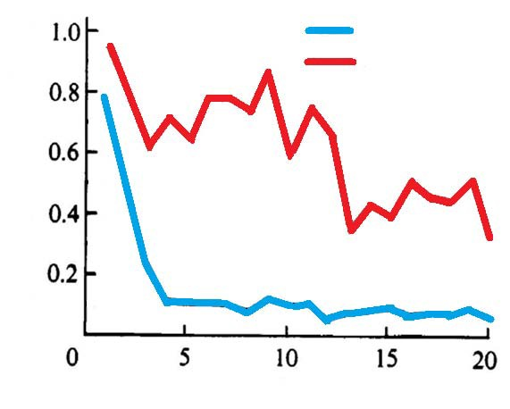
Partial-reinforcement effect
1.0
100% group
30% group
0.8
More resistant to extinction
0.6
Speed (running time /distance)
0.4
0.2
0
5
10
15
20
Trials
Notes:
The partial reinforcement effect (PRE) is the empirical finding that resistance to extinction is greater following acquisition where some, but not all, responses are reinforced (PRF); compared to acquisition all responses are reinforced (CRF).

Slide 20
Positive & Negative Punishment
For positive punishment, try to think of it as adding a negative consequence after an undesired behavior is emitted to decrease future responses.
Example: Receiving a fine for speeding
As for negative punishment, try to think of it as taking away a certain desired item after the undesired behavior happens in order to decrease future responses.
Example: Taking away a teenager's phone for not studying well.

Slide 21
Observational Learning
Observational learning, method of learning that consists of observing and modeling another individual’s behavior, attitudes, or emotional expressions. Although it is commonly believed that the observer will copy the model, American psychologist Albert Bandura stressed that individuals may simply learn from the behavior rather than imitate it.
He also emphasized that four conditions were necessary in any form of observing and modeling behavior:
Attention
Retention
Reproduction
Motivation.

Slide 22
Discuss with a partner!
Discuss a time when you learned something by classical conditioning, by operant conditioning or by observational learning.

